Slide 1



Alzheimer's Disease Detection
PROJECT PRESENTATION
BY : - AMIRA Ramzy (3CS2)
- DRAA Abdel-ilah (3CS1)

Slide 2
TABLE OF CONTENTS
01
02
03
04
05
Introduction
Methodology and Approach
Model Architecture Description
Results and Analysis
Conclusions and Future Work

Slide 3


01
INTRODUCTION
Problem Description
Dataset Overview

Slide 4

Problem Description
Alzheimer's disease is a progressive neurological disorder that affects memory, thinking, and
behavior. Early diagnosis can significantly improve the management and care for affected
individuals. This project aims to develop a deep learning model capable of classifying brain
images into categories associated with different stages of Alzheimer's disease.

Slide 5
Dataset Overview
The dataset used for this project was organized into five classes :
- Final AD JPEG (Alzheimer's Disease)
- Final CN JPEG (Cognitively Normal)
- Final EMCI JPEG (Early Mild Cognitive Impairment)
- Final LMCI JPEG (Late Mild Cognitive Impairment)
- Final MCI JPEG (Mild Cognitive Impairment)

Slide 6
Initial Class Distribution
Images reveal large amounts of data, so remember: use an image instead of a long text. Your audience will appreciate it

Slide 7
02
Methodology and Approach

Slide 8
Data Preprocessing
- Handling Class Imbalance :
To address the class imbalance, data augmentation was applied to minority classes to increase
their sample sizes. This involved generating synthetic variations of existing images through
transformations such as rotation, width and height shifts, shear, zoom, and horizontal
flipping. The augmentation process was implemented using the ImageDataGenerator class from TensorFlow.

Slide 9
Data Preprocessing
Augmentation Process:
- Augmentation was applied only to classes with fewer than 1,000 images.
- Each augmented image was saved in a separate directory corresponding to its class.
- For each class, augmentation was performed until the total number of images reached
at least 1,000.
- For augmenting data we applied :
Rescaling, Rotation, Width and Height Shifts, Shear, Zoom and Horizontal Flip

Slide 10
Data Preprocessing
Class Weight Calculation
Class weights were computed using the compute_class_weight function from sklearn to address imbalance during training. These weights were incorporated into the training process by passing them as a parameter to the “fit” method of the model. Specifically, the
class_weight argument was set to a dictionary where each class was associated with its
corresponding weight. This adjustment ensured that the loss function penalized errors for underrepresented classes more heavily

Slide 11
03
Model Architecture Description

Slide 12
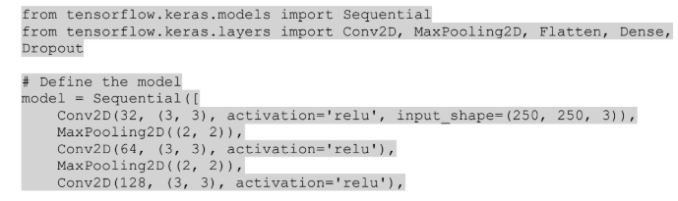
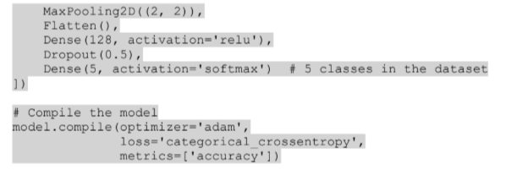
Model Architecture Description

Slide 13
Implementation Details
The model was trained for 10 epochs with the following training history:
Epoch 1/10
accuracy: 0.5186 - loss: 0.9207 - val_accuracy: 0.6374 - val_loss: 0.7522
...
Epoch 10/10
accuracy: 0.9550 - loss: 0.1188 - val_accuracy: 0.8726 - val_loss: 0.5384
Class weights were passed to the fit method to address class imbalance. Data augmentation
was applied during training, and validation accuracy consistently improved across epochs.

Slide 14
04
Results and Analysis

Slide 15
RESULTS
95.50%
87.26%
Final training accuracy
Final validation accuracy

Slide 16
ANALYSIS The model performed well on the validation and test sets, indicating good generalization. Insights: - The use of class weights and data augmentation mitigated class imbalance effectively. - Minor overfitting was observed in later epochs, which could be addressed by early stopping or regularization.

Slide 17
05
Conclusions and Future Work

Slide 18
Conclusions
This project successfully demonstrated the application of deep learning for classifying brain images into Alzheimer's disease stages. The model achieved high accuracy, proving its potential for aiding in medical diagnoses.

Slide 19
Future Work
∙ Increase dataset size by incorporating additional data sources.
∙ Explore advanced architectures like ResNet or EfficientNet for further performance improvements.
∙ Deploy the model as a web-based diagnostic tool with real-time inference capabilities.

Slide 20
THANKS!

